Slide 1


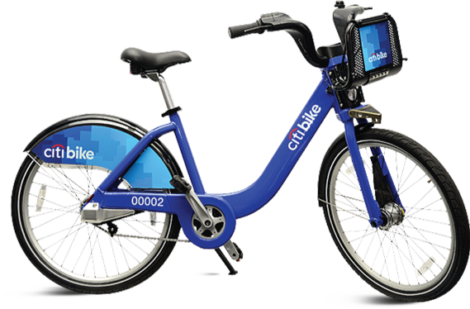

May 2020 Citi Bike Trip Data
Hemin Patel
Data 101 HW 5

Slide 2
Hypothesis 1
On an average, Women typically ride longer duration than Men
Female Mean: 1721.517 seconds
Male Mean: 1398.589 seconds
Z Score: -2.306427
P - Value: 0.9894566
Null: Both Women and Men typically ride the same duration.
With this knowledge, it is apparent that women do typically ride Citi Bikes longer than Men, disproving the Null as the mean for Female is evidently higher
Notes:
# Hypo 1: On an average, Women typically ride longer than Men.
# Mean
c.MD_mean = mean(citi.Male$tripduration) #1398.589
c.FD_mean = mean(citi.Female$tripduration) #1721.517
# Standard Deviation
sd.MD = sd(citi.Male$tripduration) # 12093.15
sd.FD = sd(citi.Female$tripduration) #14905.09
num.MD = length(citi.Male$tripduration)
num.FD = length(citi.Female$tripduration)
sd.c.s = sqrt(sd.MD^2/num.MD + sd.FD^2/num.FD)
z.score.1= (c.MD_mean - c.FD_mean)/sd.c.s
p.value.1 = 1 - pnorm(z.score.1)
# p.value = 0.9894566
# z.score= -2.306427
plot(x=seq(from = -22, to= 22, by=0.1),y=dnorm(seq(from = -22, to= 22, by=0.1),mean=1),type='l', xlab = 'Mean difference', ylab='Possibility')
abline(v= z.score.1, col = "blue")
par(bg = "transparent")

Slide 3
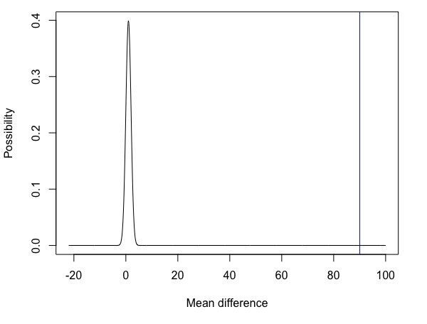
Hypothesis 2
There are more Male subscribers rather than Female subscribers.
Female Subscribers Mean: 0.3285346
Male Subscribers Mean: 0.6544596
Z Score: 90.05306
P - Value: 0 – The value is very small
Null: There is an equal amount of Male and Female subscribers.
In the graph, the blue line is to the far right, therefore we can acknowledge that there is in fact more Male subscribers than Female, disproving the Null Hypothesis.
Notes:
# Hypo 2: There are more Male subscribers rather than Female subscribers.
Citi_Sub= subset(Citi_Bike, Citi_Bike$usertype == "Subscriber")
c.Fem_mean= mean(Citi_Sub$gender == "Female")
c.Mal_mean= mean(Citi_Sub$gender == "Male")
# Standard Deviation
sd.Fem= sd(Citi_Sub$gender == "Female")
sd.Mal= sd(Citi_Sub$gender == "Male")
#Length - Count of Men and Women
num.Fem = length(Citi_Sub$gender == "Female")
num.Mal = length(Citi_Sub$gender == "Male")
sd.m.f = sqrt(sd.Mal^2/num.Mal + sd.Fem^2/num.Fem)
z.score.2= (c.Mal_mean - c.Fem_mean)/sd.m.f
p.value.2 = 1 - pnorm(z.score.2)
# P-value is 0 == the p-value is so small, it returns 0.
plot(x=seq(from = -22, to= 100, by=0.1),y=dnorm(seq(from = -22, to= 100, by=0.1),mean=1),type='l', xlab = 'Mean difference', ylab='Possibility')
abline(v= z.score.2, col = "blue")
par(bg = "transparent")

Slide 4

Notes:
#Avg Age of User Types
agealc <- function(birth.year, current){
require(Citi_Bike.table)
y <- year(current) - year(birth.year) -1
age <- y
return (age)
}
k <- aggregate(Age ~ usertype, data= Citi_Bike, FUN = mean)
write.csv(k, 'Age_User.csv')
Age_User <- read.csv("~/Desktop/Data 101/HW 3/Age_User.csv")
t <- list(
family = "sans serif",
size= 16,
color = 'white')
fig <- plot_ly(x = c(Age_User$usertype), y = c(Age_User$Age), width = 700, height = 700, type = 'bar', marker = list(color = '#003B70')) %>%
layout(title= list(text = "Average Age of User Types",font = t), font=t,
xaxis = list(title = list(text ='User Types', font = t)),
yaxis = list(title = list(text ='Average Age of Users', font = t)),
plot_bgcolor='#e5ecf6', paper_bgcolor='#58A0DB')
# api_create(p=fig, filename = "Average Age of User Types")
fig
#--------------------------------------------
#Sub & Cust Count
Sub_Cust <- table(Citi_Bike$usertype)
View(Sub_Cust)
Sub_Cust1 <- write.csv(Sub_Cust, "Sub_Cust.csv")
data_nohead <- read.csv("Sub_Cust.csv", header = TRUE)
colnames(data_nohead) <- c(" ", "User Type", "Count")
View(data_nohead)

